Slide 1
Azure OpenAI
创新应用场景和案例

Slide 2
议 程
新一代创新智能场景
客户创新案例
OpenAI赋能微软产品

Slide 3
新一代创新智能场景

Slide 4

语言模型
Azure OpenAI
应用场景
结构化和非结构化数据的推理：分类，情感，实体提取，搜索
使用嵌入模型改进文本搜索
产品反馈情绪
客户和员工反馈分类
索赔和风险分析
支持邮件和通话记录
社交媒体趋势
写作辅助
营销文案/邮件标语
长格式文本
根据要点分段
摘要模型
呼叫中心电话记录
SME 文档
竞争性分析
同行分析
技术报告
产品和服务反馈
社交媒体趋势
会话 AI
为呼叫中心提供智能协助
技术支持聊天机器人
虚拟助手
虚拟人
GPT-4代码生成
自然语言转换成代码
自然语言转换成SQL
代码转换成自然语言
代码注释
代码重构
多模型应用场景
客服中心
分类 - 将邮件发送到合适的分组
情绪 - 优先应对情绪不佳的客户
实体提取和搜索 - 分析责任和风险
邮件和电话记录总结
客户邮件答复的生成
营销活动快速响应：分类、情感、汇总、内容生成、图像生成
DALL·E
创意构思
播客和音乐播放列表图像
内容聚合
营销活动个性化
高级定制
Notes:
5-10 mins

Slide 5


Azure OpenAI | Top 5 功能和用户案例
客户服务
销售市场
内容生成
知识管理
辅助决策
基于特定任务或知识的
问答机器人
舆情监控
社交媒体趋势总结
专业主题文档生成
(财务报告，分析师文章)
企业内部的知识挖掘和检索
自然语言交互的
自服务数据查询
客户服务
泛化的闲聊机器人
客制化的产品推荐
代码生成和代码注释
针对特定知识体系的
培训资料和问答系统
决策者的数据顾问
Chat your Customers
Chat your Web
Chat your Products
Chat your Docs
Chat your Data
案例
问答式企业知识搜索（Chat your Web）: 针对特定文章做内容检索、摘要生成、自然语言答复，做企业内部的New Bing
智能文档处理 (Chat your Doc )：针对纸质化，图片等非结构化数据进行文字识别和关键信息抽取，并通过RPA系统进行自动录入
智能数据Copilot (Chat your Data)：针对企业现有数据提供基于自然语言实现零代码的数据自服务查询
Notes:
Customer Service
Sales and Marketing
Content Creation
Knowledge Mgmt/Internal Training
Decision Support

Slide 6

















企业级AI能力输出
Applications
Partner Solutions
Business Users
Application Platform
AI Builder
Power BI
Power Apps
Power Automate
Power Virtual Agents
Scenario-Based Services
Applied AI Services
Bot Service
Cognitive Search
Form Recognizer
Video Indexer
Metrics Advisor
Immersive Reader
Customizable AI Models
Cognitive Services
Developers & Data Scientists
Vision
Speech
Language
Decision
OpenAI Service
ML Platform
Azure Machine Learning
Notes:
Narrative/talk track:
Azure AI is a collection of artificial intelligence services offered by Microsoft as part of its Azure cloud platform. The Azure AI services are designed to make it easy for developers and organizations to add AI capabilities to their applications, without the need for extensive expertise in AI.
Azure AI includes a wide range of services, such as:
Azure Cognitive Services: A collection of pre-built APIs that allow developers to add capabilities such as natural language understanding, computer vision, and speech recognition to their applications.
Azure Machine Learning: A cloud-based platform that allows developers to build, deploy, and manage machine learning models, as well as to create custom machine learning algorithms.
Azure Applied AI Services: A suite of scenarios-based services that enable organizations to accelerate adoption such as Azure Cognitive Search which provides search capabilities over structured and unstructured data by using machine learning models.
These services are integrated with Azure platform, which provides capabilities such as scalability, security, and compliance, as well as a number of other tools and services that can be used to build and deploy AI-enabled applications.
The Azure AI services are designed to make it easy for developers and organizations to add AI capabilities to their applications, without the need for extensive expertise in AI. Microsoft's Azure AI services allow developers to quickly build, deploy, and scale AI-enabled applications, and to take advantage of the scalability, security, and compliance capabilities of Azure.
Azure AI integration in AI Builder within the Microsoft Power Platform allows businesses and developers to quickly and easily build and deploy custom AI models, and to integrate them with Power Apps, Power Automate and Power Virtual Agents, in order to add advanced capabilities and improve data management and security. It also allows to easily scale up and improve performance of the models, as well as easily integrating with other Azure services.
Microsoft has adopted Azure AI across a wide range of its products and services, in order to improve the functionality, performance and user experience. Some examples of where Microsoft has adopted Azure AI at scale include:
Office 365: Microsoft has integrated Azure AI capabilities into Office 365, such as natural language processing, computer vision, and text analytics, to improve the functionality of products such as Outlook and Word. This allows users to perform tasks such as automatically summarizing long documents, or automatically tagging images in email attachments.
Dynamics 365: Dynamics 365 is a collection of business applications that enable organizations to manage customer data and interactions, as well as automate business processes. With Azure AI integration, Dynamics 365 offers features like predictive lead scoring, sentiment analysis, and chatbots to help businesses better understand and interact with their customers.
Bing: Bing, Microsoft's search engine, uses Azure AI to analyze large amounts of data and improve search results for users. For example, Bing uses natural language processing to understand users' queries and generate more relevant search results.
LinkedIn: Microsoft's professional networking site, LinkedIn, uses Azure AI to help users find job opportunities, connect with others in their field, and improve the performance of its recruiting tools. For example, LinkedIn uses natural language processing to match job seekers with relevant job opportunities, and uses machine learning to help recruiters find the best candidates.
Xbox and Gaming: Microsoft uses Azure AI to power its Xbox gaming console. Azure AI allows Xbox to learn a gamer's preferences and automatically adjust the gaming experience. Additionally, it allows to improve the performance of the games and to offer more personalized gaming experiences.
These are just a few examples of how Microsoft has adopted Azure AI at scale within its products and services. Overall, Microsoft has been using Azure AI across its various products and services, to improve user experience and to offer more personalized, efficient and automated experiences to its customers.

Slide 7
客户创新案例

Slide 8



场景案例 – Chat your Video
主题分类/标签化
全球变暖， 森林砍伐， 碳足迹
关键信息抽取
组织：政府间气候变化专门委员会、联合国气候变化框架公约、绿色和平 地理：加拿大、美国
关键词
人类活动、化石燃料、地球大气
内容分析
知识问答
什么是政府间气候变化专门委员会（IPCC）？ IPCC是一个研究气候变化及其有效性的国际组织。
azure video indexer
语音转文字
Azure
OpenAI
内容理解与生成
视频内容总结
新闻广播
（全球变暖）
内容生成
本文讨论了全球变暖及其对地球大气、野生动物和人类社区的影响。它指出全球变暖的主要原因是......
文章生成 (博客、社交媒体)
全球变暖是地球大气整体温度逐渐升高，主要引起...
视频脚本生成
第一幕：节目以一个美丽的海滨小镇的镜头开场 第二幕：当小镇努力应对危机时......
个性化内容生成（或广告）
Simon，作为一个对全球变暖充满热情的人，你知道它对我们星球构成的紧迫威胁......

Slide 9
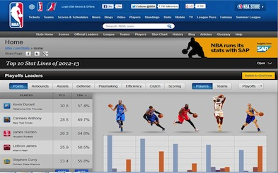

场景案例 – Chat your Data
“勒布朗詹姆斯在 2021 年得到了多少分？”
Azure
OpenAI
Codex
Sports Stats
Database
basketball_stats (player, team, points, rebounds, assists, steals, blocks, turnovers, games_played)
("LeBron James", "Los Angeles Lakers", 25, 7, 10, 1, 0, 3, 82), ("Kevin Durant", "Brooklyn Nets", 30, 7, 4, 1, 2, 3, 72)
basketball_games (home_team, away_team, home_score, away_score, game_date)
("Los Angeles Lakers", "Brooklyn Nets", 110, 105, '2021-12-01'), ("Milwaukee Bucks", "Golden State Warriors", 120, 115, '2021-12-02')
SELECT SUM(points) FROM basketball_stats WHERE player = 'LeBron James' AND game_date BETWEEN '2021-01-01' AND '2021-12-31';

Slide 10

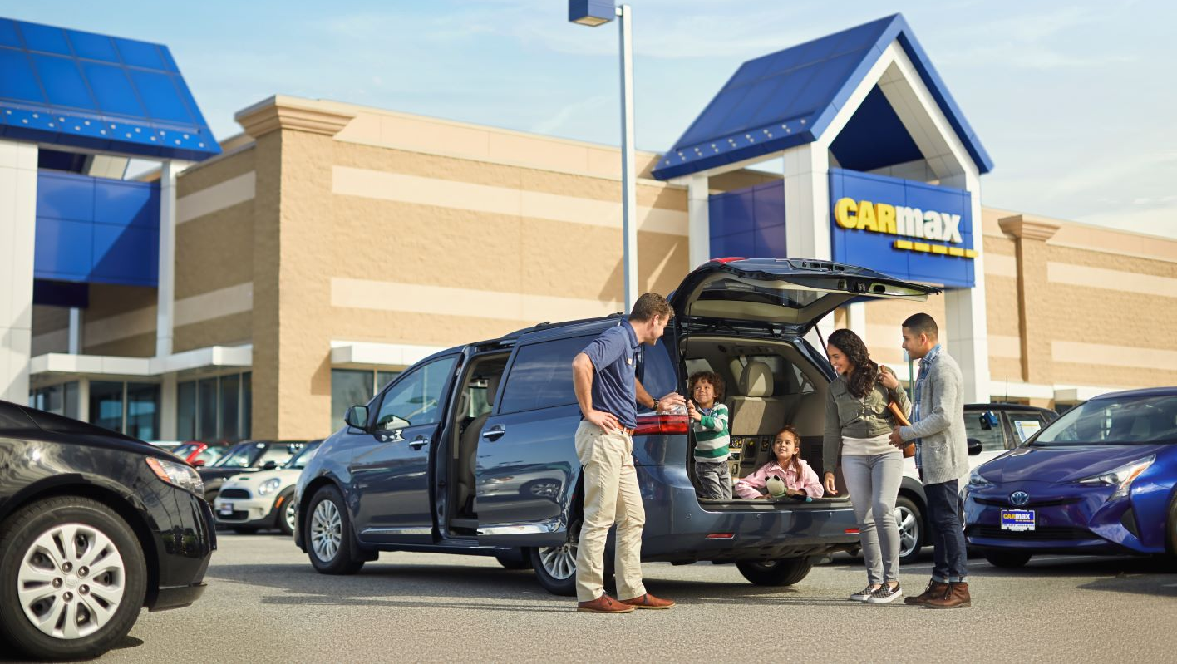



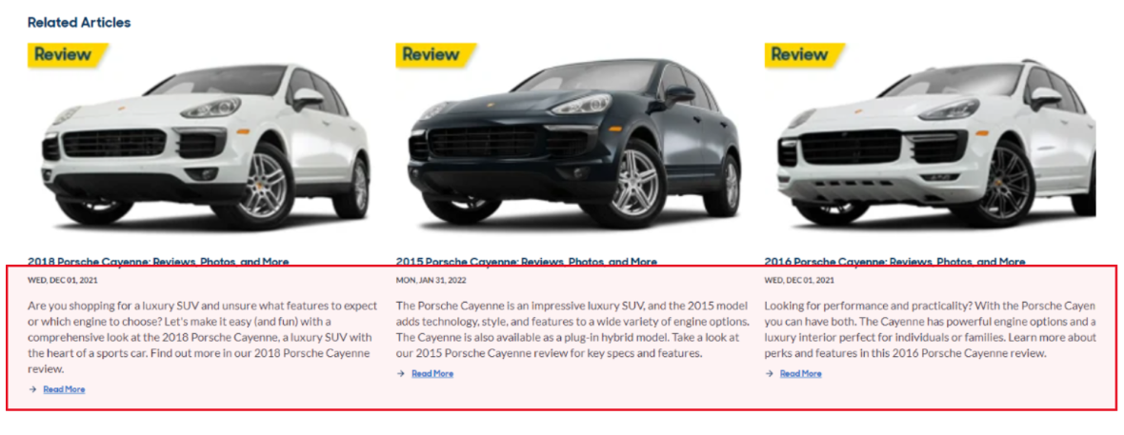
CarMax 使用 Azure OpenAI Service 汇总客户对车辆和门店的评价，创建营销内容，提供车辆内饰对比信息。使用 OpenAI 节省了他们的市场外勤人员支出，使他们能够领先竞争对手向客户提供新信息。
比较
“通过 Azure OpenAI 服务，我们可以创建营销内容，提前触达客户，推动决策。”
Shamim Mohammad, CarMax 执行副总裁兼首席信息和技术官 “
“OpenAI Service 无疑在我们的 SEO 优化中发挥了重要作用。”
Sean Goetz,应用系统总监
Notes:
Microsoft Customer Story-CarMax puts customers first with car research tools powered by Azure OpenAI Service
自 1993 年以来，CarMax 已从一家颠覆行业的初创公司发展成为美国领先的二手车零售商。 不过，CarMax 并不满足于这一成功——该公司不断寻求创新方法，为众多客户提供更好的购车体验。 在 Microsoft Azure OpenAI 服务的帮助下，CarMax 简化了其汽车研究页面文本摘要的创建，快速为客户提供有意义的内容，同时提高了页面的搜索引擎排名。 以这一成功为基础，CarMax 期望在其网站上添加更多人工智能生成的内容。
挑战：CarMax 的库存中有 45,000 辆汽车，因此需要一种快速高效的方法来分析客户评论并为每种型号提供简短、有意义的摘要，以帮助潜在购买者并提高页面的搜索引擎排名。
解决方案：选择与 OpenAI 合作后，CarMax 迁移到 OpenAI 服务，以利用它提供的可扩展性、安全性和负责任的 AI 功能。
影响：CarMax 能够在几个月内制作出相当于 11 年的汽车摘要，让编辑人员能够专注于更实质性的内容，为客户提供有价值的见解，并成功提升搜索排名。
https://customers.microsoft.com/en-us/story/1501304071775762777-carmax-retailer-azure-openai-service

Slide 11



汇总并提取文档相似性，挖掘相似聚类，生成聚类主题
文本聚类
文档嵌入
聚类（k 均值）
提取群集主题：在同一聚类中的文档之间进行汇总
Doc1 | [0.5622, 0.4530, 0.2848, …, 0.5325]
Doc2 | [0.0015, 0.9407, 0.2201, …, 0.1942]
Doc3 | [0.0033, 0.7006, 0.0576, …, 0.0517]
Cluster 1 Theme: Sports News Stories | Cluster 1 Theme: Sports News Stories
Doc summary: | “New York Yankees Win World Series in Dramatic Game 7 Finish”
Doc summary: | "Usain Bolt Sets New World Record in 100m Dash at Olympics"
Doc summary: | "Tiger Woods Claims Masters Title for the Sixth Time"
Azure OpenAI Service
文档摘要
Azure OpenAI Service
文档
第二组主题：财经新闻报道 | Cluster 1 Theme: Sports News Stories
Doc summary: | "Tech Giant XYZ's Stock Surges 20% Following Strong Earnings Report"
Doc summary: | "Fed Interest Rates Remain Unchanged Following Policy Meeting"
Doc summary: | "Oil Prices Plummet as Demand Weakens Due to COVID-19 Pandemic"
Doc1 | [ Text document summary ]
Doc2 | [ Text document summary ]
Doc3 | [ Text document summary ]
Azure OpenAI Service
Scikit-learn
Azure Machine Learning Workspace
Azure OpenAI Service

Slide 12
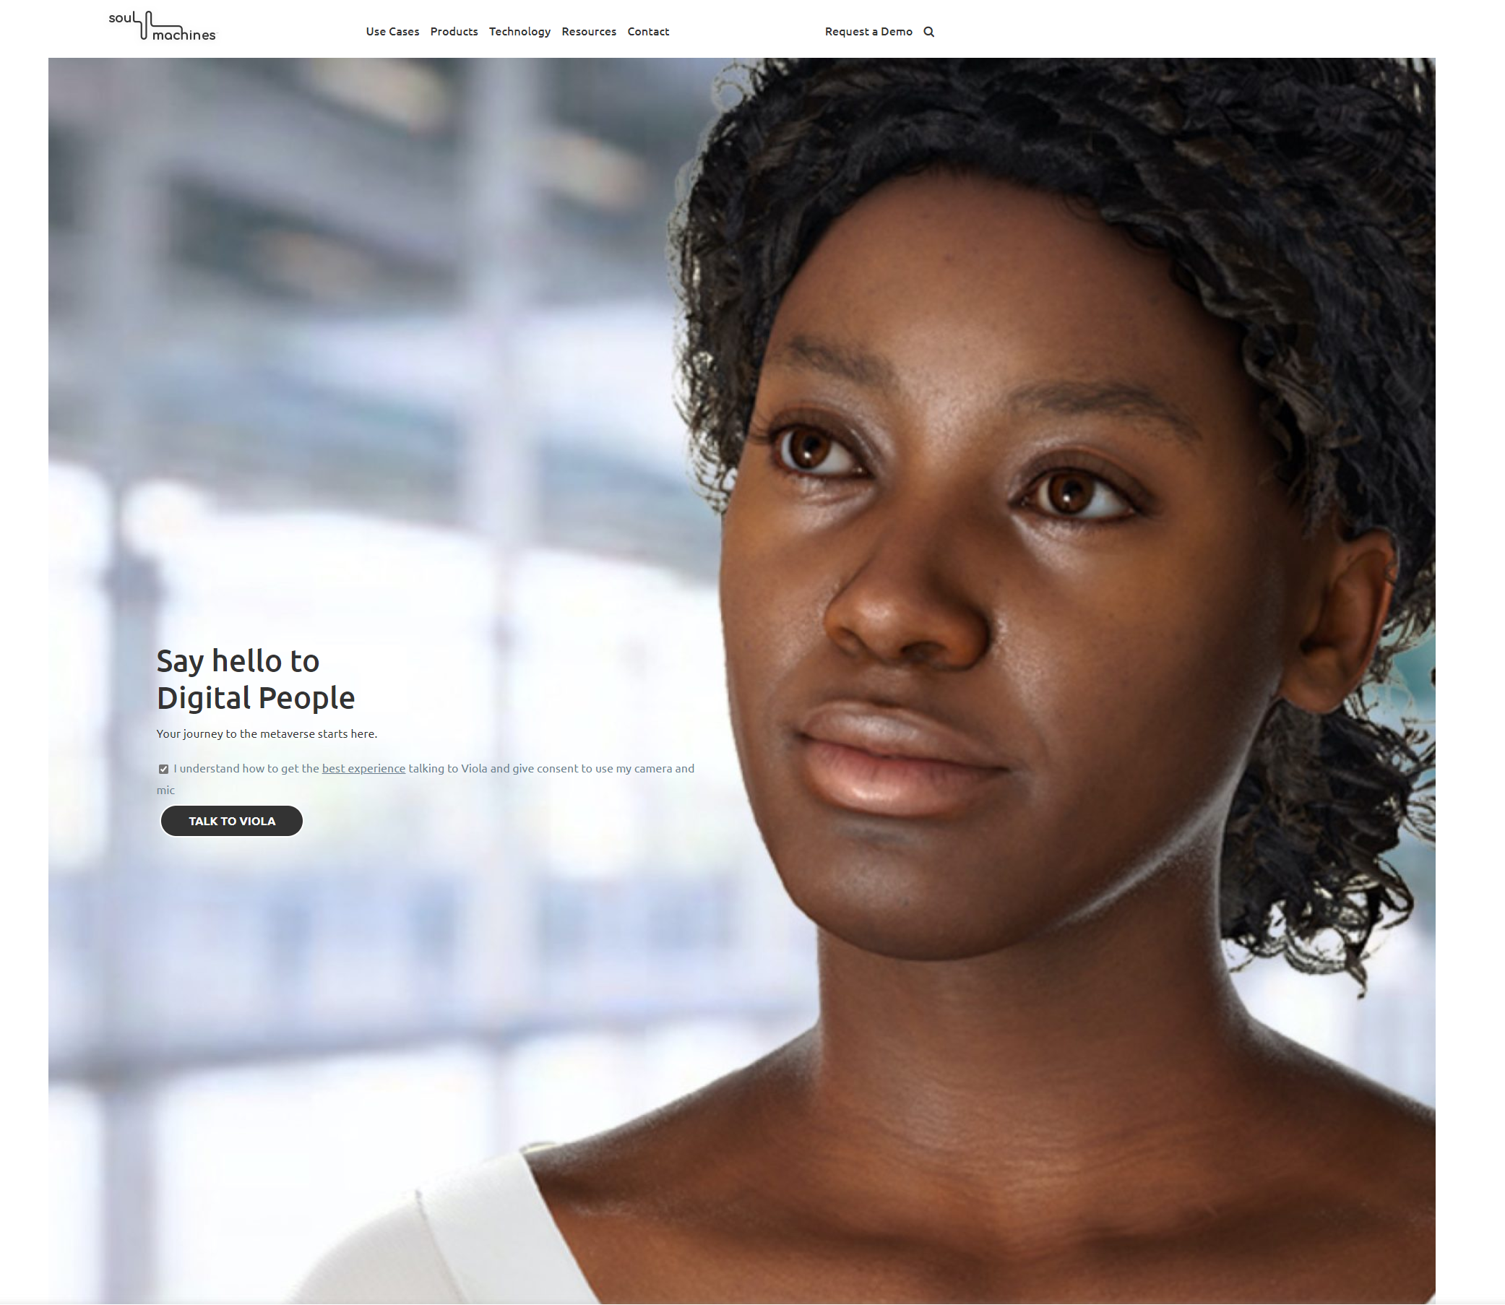

Soul Machines 创造的数字人可以与客户建立互动及情感联系，进而改变品牌体验。
Soul Machines 正将 OpenAI 用于情感塑造，以增加数字人的同理心，从而使其与用户进行更深入、更具意义的对话。
“Soul Machines 正在使用 Azure OpenAI 服务为他们的媒体和娱乐产品自动生成内容。例如，内容生成可以帮助他们复制生成带有头像和人物的对话。”

Slide 13


Farmlands 是新西兰最大的农产品收购集团。根据 Dynamics 365 系统记录，他们每年与客户有超过 45 万次互动联系。
他们使用 Azure OpenAI Service 来获取 Dynamics 沟通记录中出现的关键字或短语及其所传达的情绪价值。
他们用 Davinci 和 Curie 模型来捕捉当前的高频关键词，并进行总结，用户可以进一步查看事件或沟通概要。
“它节省了我们呼叫中心工作人员的时间，改善了客户体验”
– Gareth Pullar, Farmlands 洞察和分析经理
“内容生成改变了游戏规则。这真的是一项振奋人心的技术。”
– Jean van Schalkwyk, 商业智能主管

Slide 14





使用 Speech API 和 OpenAI 对呼叫中心进行分析
从电话记录中提取大量见解
PowerBI Insights
(接近实时)
呼叫者
智能转录
对话的趋势和见解
人与人之间的
交谈
音频文件
电话
服务器
Azure
存储
Azure STT
语音转文字
Azure OpenAI 服务
CRM
Azure 认知服务–
语音和 OpenAI
呼叫中心代理
详细的通话记录，包括概要，通话原因等.
Notes:
Azure OpenAI 服务使我们能够从联络中心的客户对话中提取丰富的见解。 为实现这一点，代理和客户之间的通话被记录并存储在 Azure 存储中。 从这里开始，我们的 Speech API with Speech to Text 将音频转换为书面文本。 为此，可以使用我们的 Batch Ingestion 客户端： Ingestion Client - Speech service - Azure Cognitive Services | 微软学习。 下一步，输出被送入 Azure OpenAI 服务，在那里进行汇总和信息提取。 通常，座席需要花费几分钟时间手动记下这些数据，但在这里，它是完全自动化的，这为座席每次通话节省了几分钟时间。 然后可以将此输出输入 PowerBI 以获得近乎实时的洞察力，因此操作员可以了解联络中心正在发生的事情。 此外，此信息可以存储在 CRM 中，因此座席可以全面了解客户过去致电的原因，并能够更快地解决问题。

Slide 15


客户: Trelent
行业: 专业服务
规模（员工数）: 1-49
国家: 加拿大 产品和服务: Azure OpenAI Service
阅读完整案例
“有 OpenAI Service 这样的产品提供支持，你可以把更多精力放在真正重要的事情上，专注于为客户提供优质的体验、出色的产品和更大的价值。”
—Calum Bird, CEO, Trelent
Trelent 是一家提供代码文档解决方案的种子轮初创公司，他们使用 OpenAI Codex 算法发现目标受众来自于高速增长的科技公司，这些公司的技术团队普遍大而分散。
问题：一个只有两人的团队如何为客户提供企业级服务?
他们在一场微软面向初创公司的研讨会上找到了答案：微软 Azure OpenAI Service 可匹配 Trelent 正在使用的强大的 OpenAI 算法和 Azure 安全防护、安全管控技术，还可以凭借 Azure 全球可用的优势，与初创公司现有的解决方案形成合力。
有了 Azure OpenAI Service 的支持, Trelent 的方案在内容过滤、安全性提升和响应时间缩减方面(从1-3秒下降到平均750毫秒)都受益颇深。这些企业级功能极大地解放了 Trelent 工程师的生产力，使他们可以专注于核心创新业务。

Slide 16
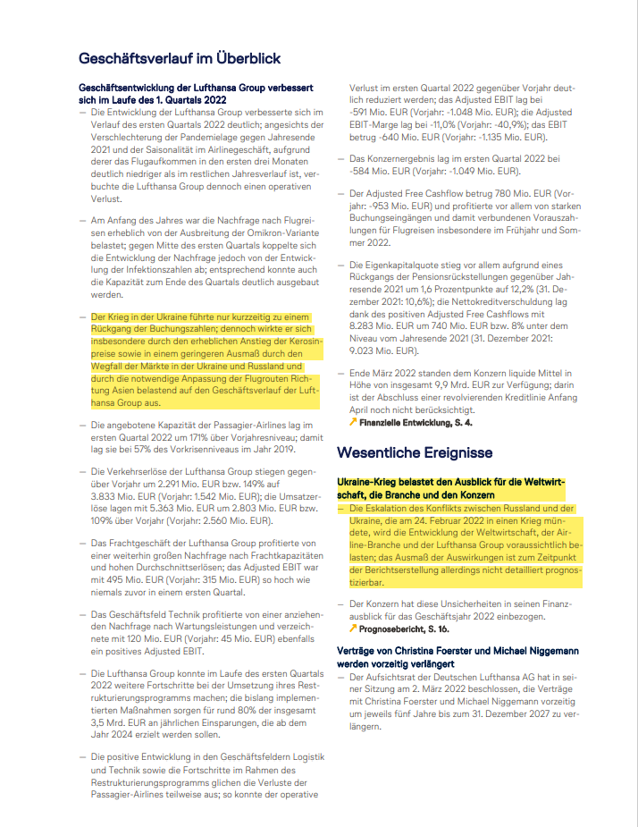
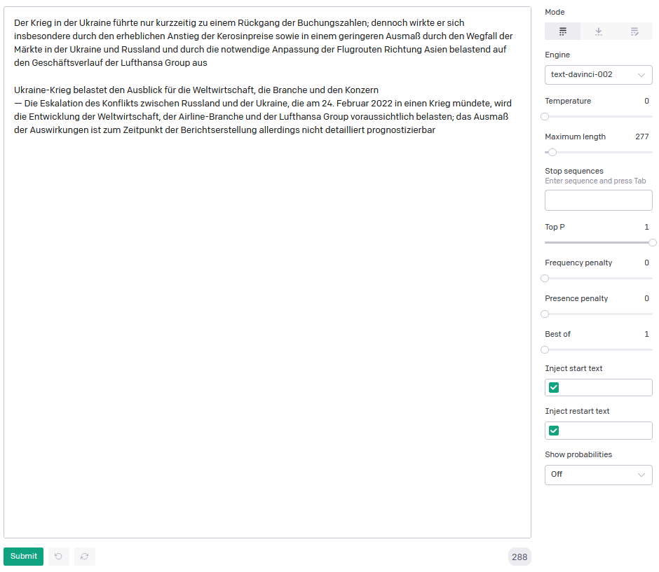

案例:文档智能搜索
根据年度或季度报告评估乌克兰危机的风险/机遇 GPT-3 将风险或机会分为大、中、小两类
通过汇总多个时间点和投资组合中所有公司的结构化结果进行投资组合评估
2021
QU 1 2022
→
→
乌克兰危机是一个大、中或小的机会，还是一个大、中或小的风险？
乌克兰危机是汉莎航空面临的主要风险。
德国汉莎航空公司
Heckler & Koch AG
莱茵金属股份公司
...

Slide 17




企业多模态数据知识库智能搜索架构
PDF OCR pipeline
Azure Functions
Web Application
Documents
Azure Form Recognizer
Azure OpenAI Service Embeddings model
Azure Cache for Redis (Enterprise)
Power BI
Azure OpenAI Service
Prompt: Passage QnA

Slide 18








Similarity search
商品推荐
Product
Embeddings
Saffron Ella $2,300
Signature series
Slate Ray $2,300
Signature series
Similarity Search
Azure
OpenAI Service
Embeddings
Desk
Chair
Table
Couch
Customer
Product
Database
Embeddings Space

Slide 19



游戏及娱乐行业Dall-E 例子
an expressive oil painting of a basketball player dunking, depicted as an explosion of a nebula
Avocados dancing, drinking, singing and partying at a Hawaiian luau
a bowl of soup that looks like a monster, knitted out of wool

Slide 20
OpenAI赋能微软产品

Slide 21









Microsoft AI and OpenAI
Vision Service
更优的搜索和问答体验
Turing
丰富的语言理解
Speech Service
提升客户参与和支持度
Z-Code
100 种语言翻译
Azure 认知服务
Language Service
更合适，更精准的内容匹配
Decision Service
Florence
突破性视觉识别
OpenAI Service
更简单的邮件管理和会议规划
OpenAI
Cognitive Search
更便捷的知识管理
GPT
类人语言生成
Form Recognizer
应用 Azure 技术的 AI 服务
更高效的会议管理
Immersive Reader
DALL-E
真实图像生成
更好的阅读和写作辅助
Bot Service
Codex
高级代码生成
Video Analyzer
更合适、精准的内容

Slide 22

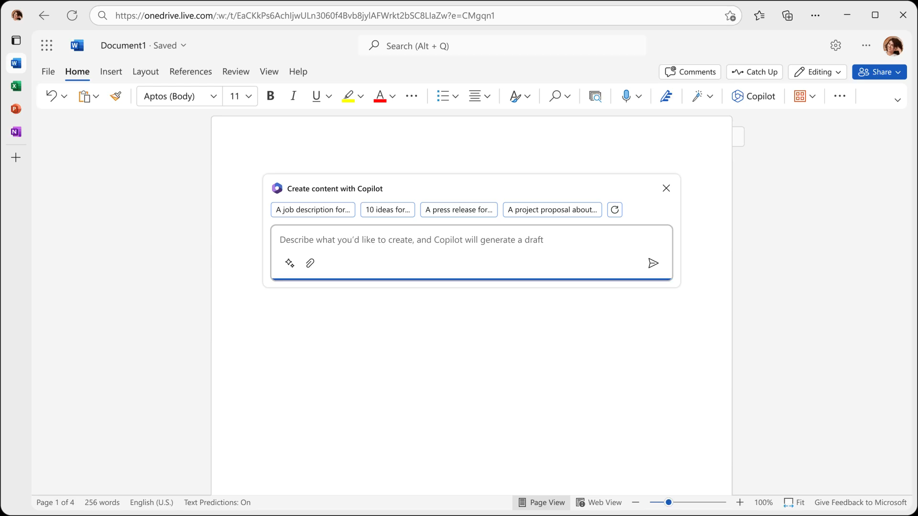
Copilot in Word
Copilot写作、编辑、总结、创造
您可以询问 Copilot：
根据 [Document] 和 [Excel] 中的数据起草一份两页的项目提案
使第三段更简洁，将文档的语气更改为更随意
根据此粗略大纲创建一页草稿。
Notes:
Copilot is a game changer.
If you ever stared at a blank page wondering how to begin document – that experience is over.
Copilot will jump-start the creative process so you never start with a blank slate again.
It writes, edits, summarizes, and creates right alongside you.

Slide 23

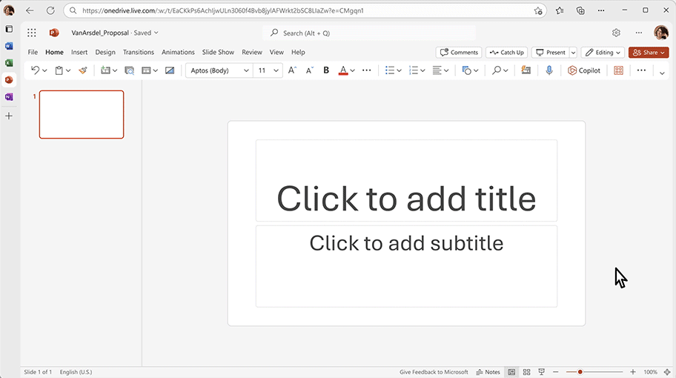
Copilot in PowerPoint
Copilot帮助您实现从idea到PPT的秒级转换
您可以询问 Copilot：
创建五张幻灯片的演示文稿基于给定的Word 文档，并包含相关的照片
将此演示文稿合并为三张幻灯片摘要
将这三个项目符号重新格式化为 三列，每列都有一张图片。
Notes:
It’s remarkable.
Copilot becomes your storytelling partner.
It can transform existing written documents into decks complete with speaker notes and sources,
You can also start a new presentation from a simple prompt or outline. Or condense lengthy presentations at the click of a button, and use natural language commands to adjust layouts, reformat text, and perfectly time.

Slide 24

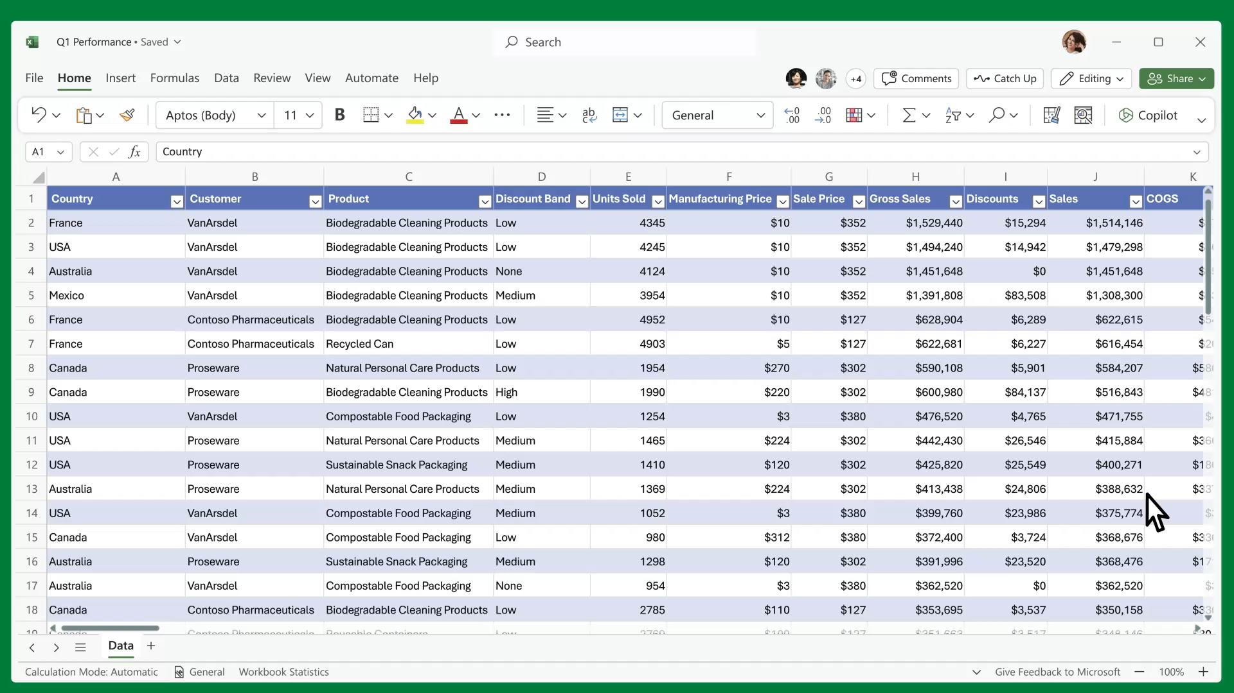
Copilot in Excel
Copilot 与您并肩工作，帮助分析和探索您的数据
您可以询问 Copilot：
按类型和渠道细分销售，插入表格
预测 [variable] 的影响并生成图表以帮助可视化
模拟 [variable] 增长率的变化将如何影响我的毛利率
Notes:
Remember, the average person uses less than10 percent of what PowerPoint can do.
Copilot unlocks the other 90 percent.
Copilot in Excel puts all the rich capabilities of Excel at your fingertips.
It can analyze trends and create professional-looking data visualizations in seconds, and it will reveal correlations, propose what-if scenarios, and suggest new formulas based on your questions.
It generates models based on your questions that help you explore your data without modifying it

Slide 25
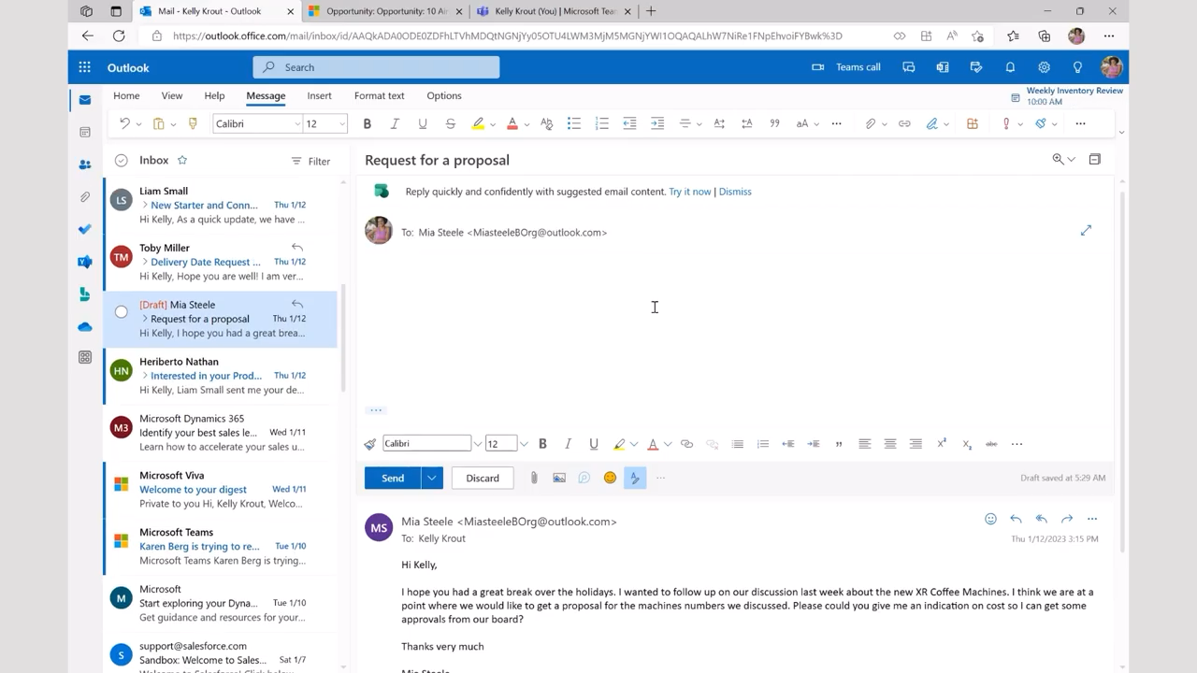
Viva Sales
个性化电子邮件建议
Notes:
Customers can generate Power Fx formulas with the help of the GPT-3 model and use them to build your app in Power Platform.
More information: Getting Started with GPT-3 in Power Platform - Developer Support (microsoft.com)

Slide 26

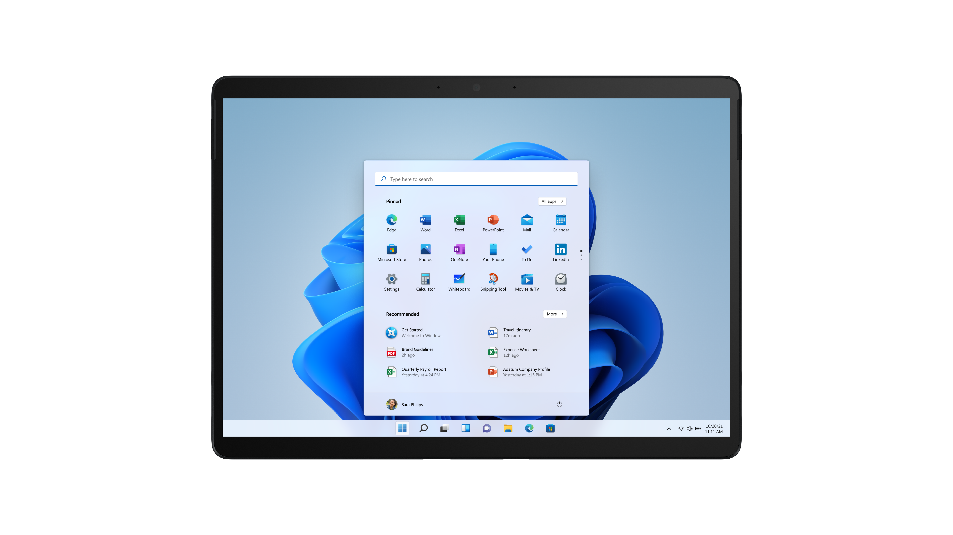
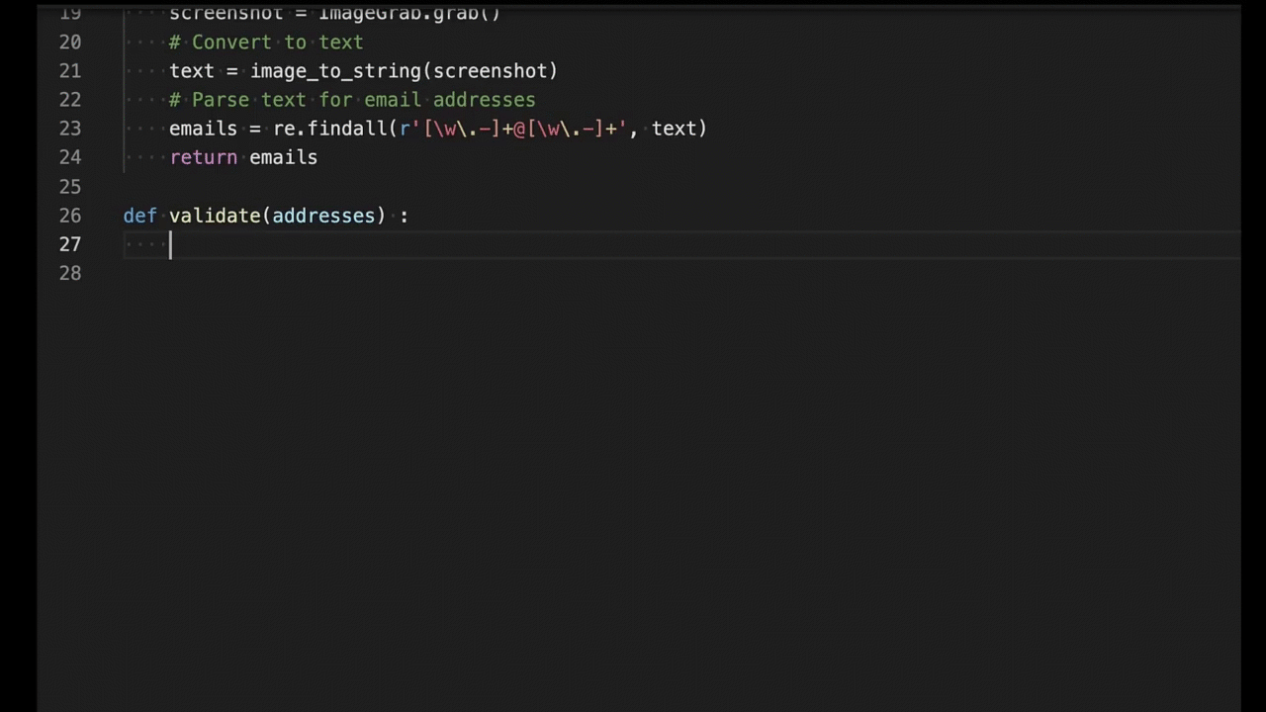
GitHub Copilot
你的专属AI程序员
Notes:
GitHub Copilot draws context from the code you’re working on and suggests whole lines or entire functions. As you type, it adapts to the way you write code to help you complete your work faster.
More information: GitHub Copilot · Your AI pair programmer

Slide 27
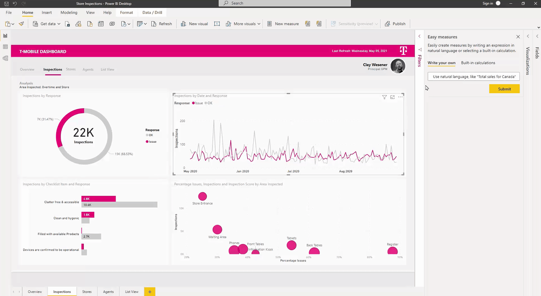
Power BI
用自然语言生成 DAX 表达式
Notes:
Customers can use natural language to describe what they’re trying to accomplish and have Power BI automatically create a DAX expression for them, powered by GPT-3. By using natural language to create DAX calculations, we are further democratizing the ability to create sophisticated business logic without having to become a DAX expert.
More information: Enabling intelligent experiences with Power BI for developers, data scientists, and data engineers | Microsoft Power BI Blog | Microsoft Power BI

Slide 28
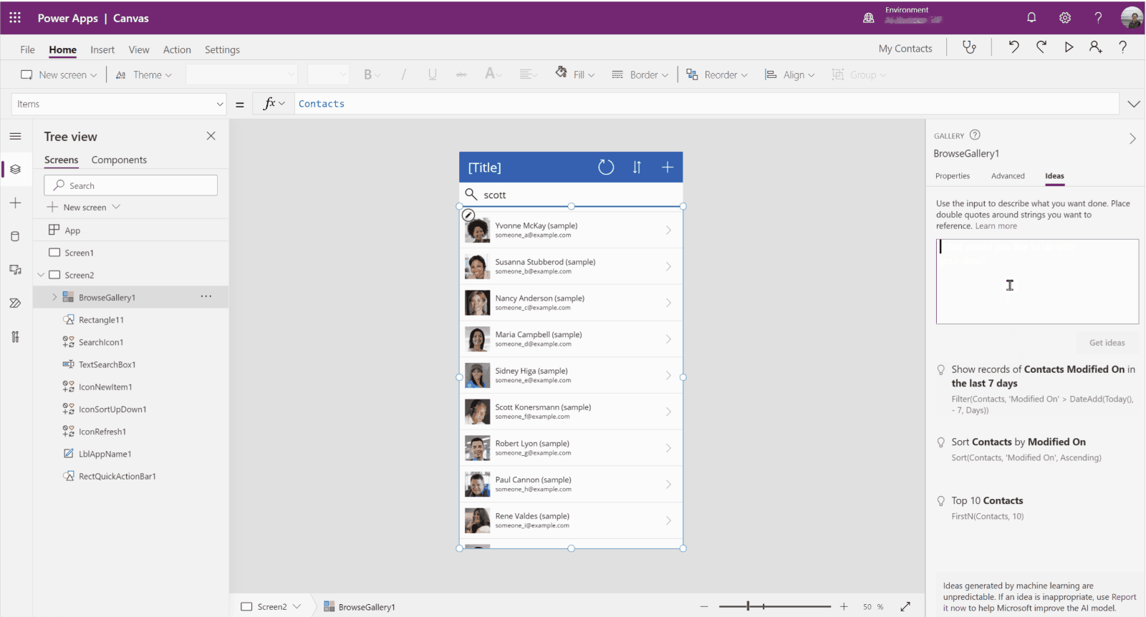
Power Platform
Power Fx 公式
Notes:
Customers can generate Power Fx formulas with the help of the GPT-3 model and use them to build your app in Power Platform.
More information: Getting Started with GPT-3 in Power Platform - Developer Support (microsoft.com)

Slide 29
谢谢

Slide 30

Notes:
Thank you

